Slide 1
Our New Projects
“All visuals are AI-generated base concepts further refined and customized with our own unique design modifications.” and Will manufacture in our own Factory

Slide 2
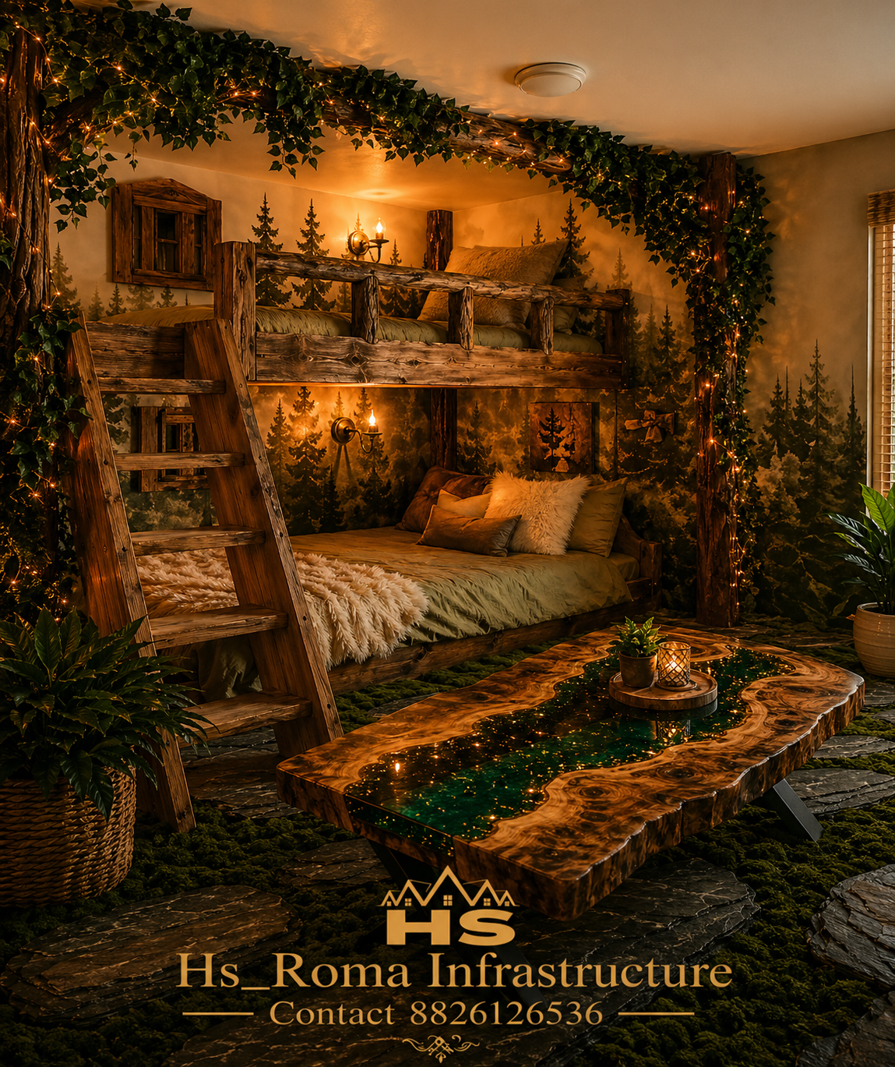
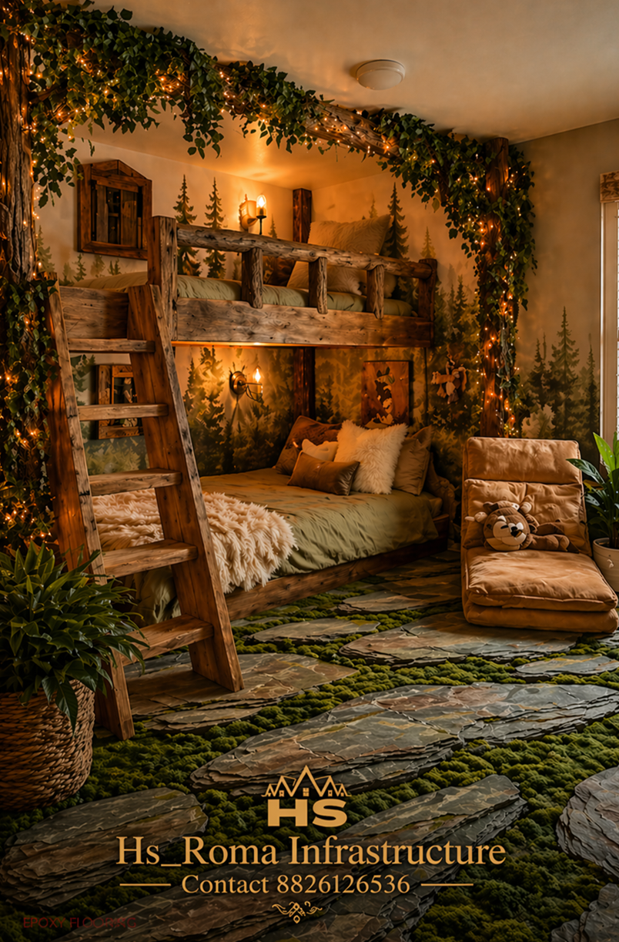
HS Roma Eco Luxury Cabin Interior with Epoxy Table and Floor
Notes:
With River Table (Epoxy)

Slide 3
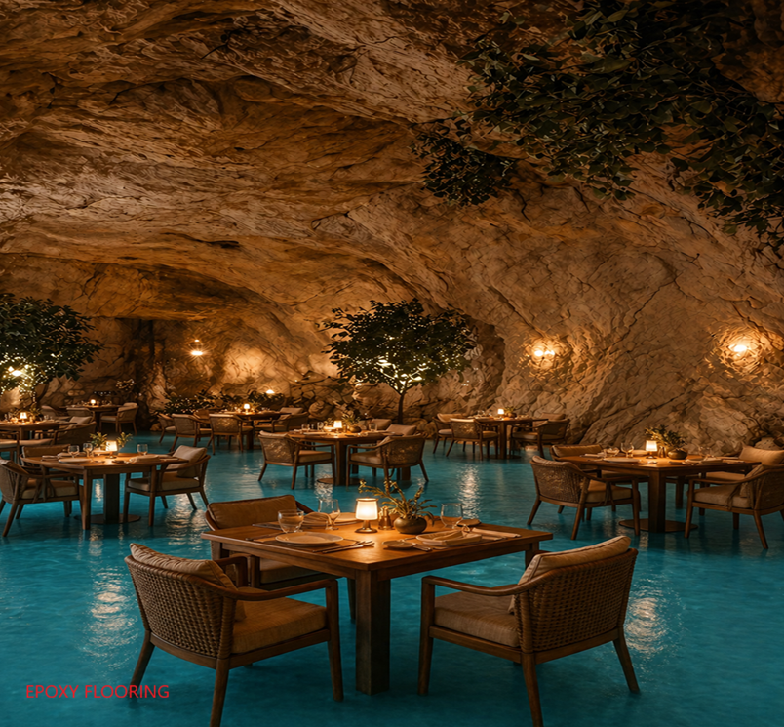
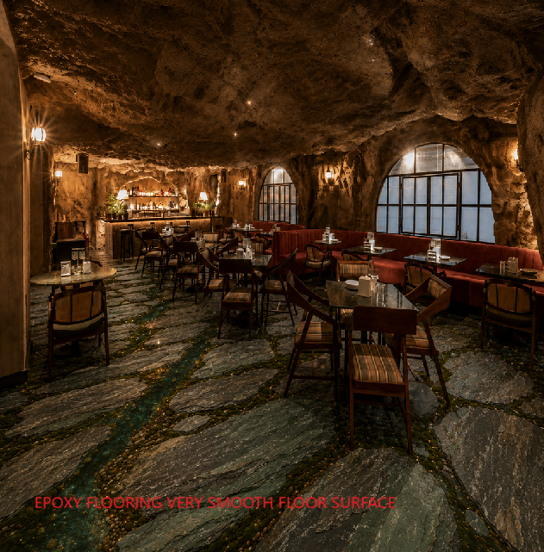
HS Roma Luxury Cave Dining

Slide 4
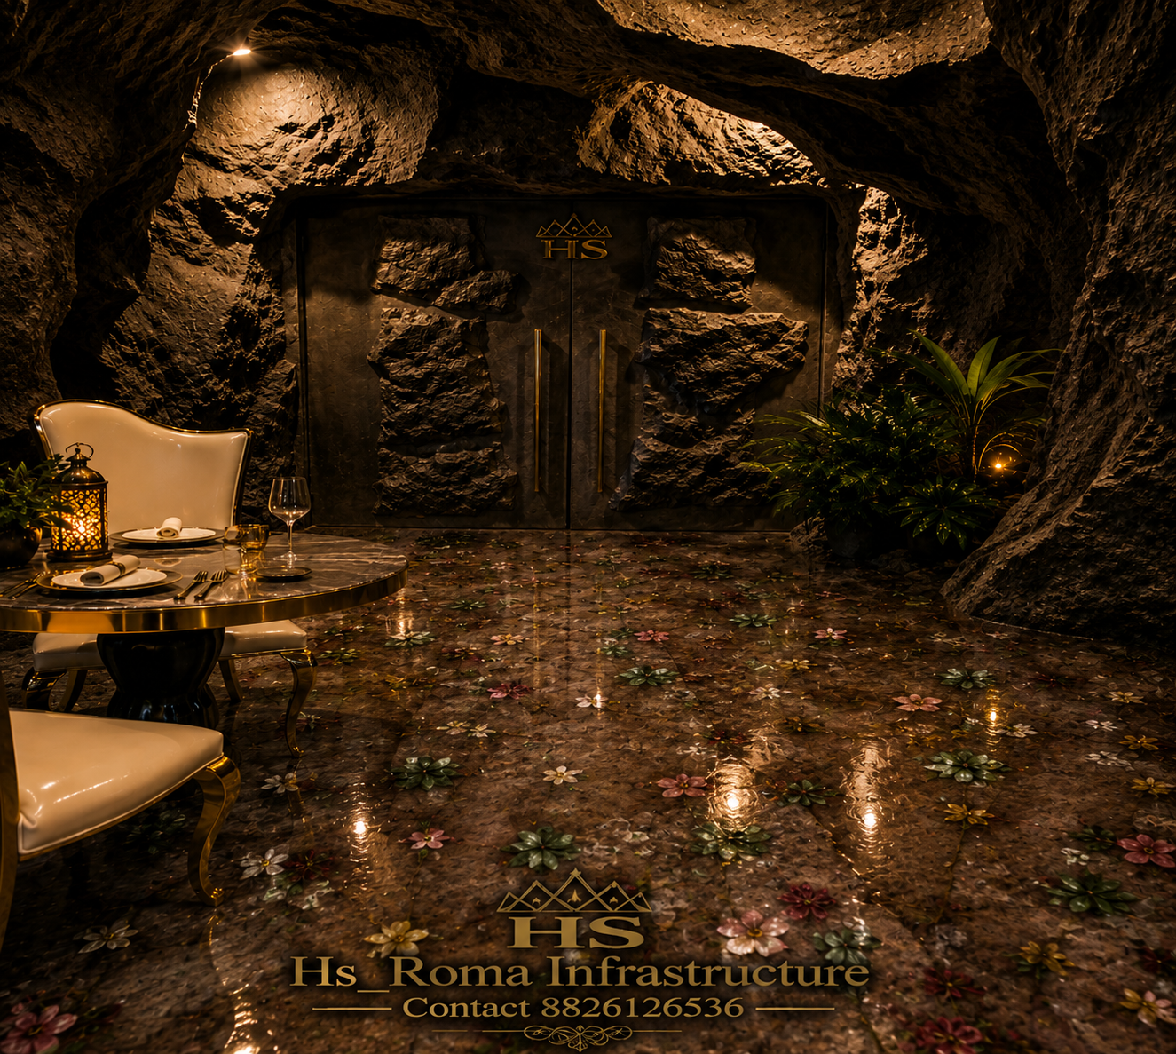
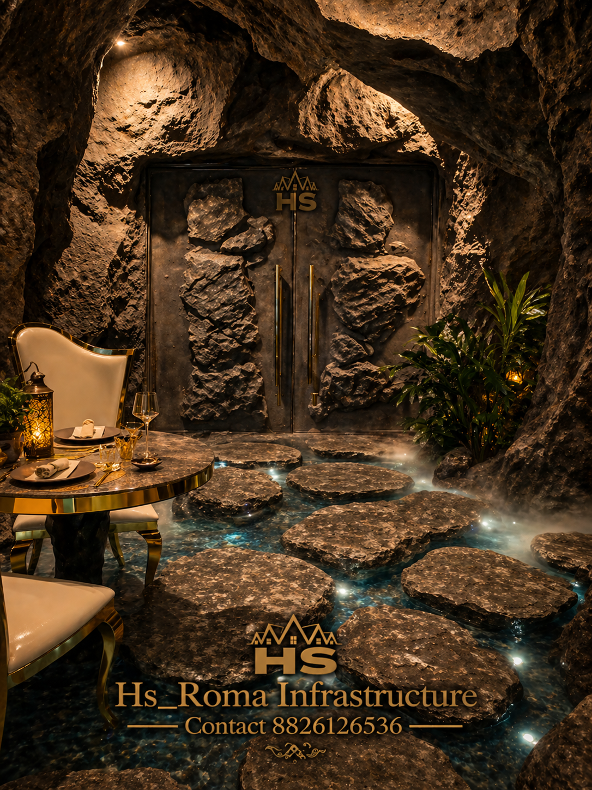

Slide 5
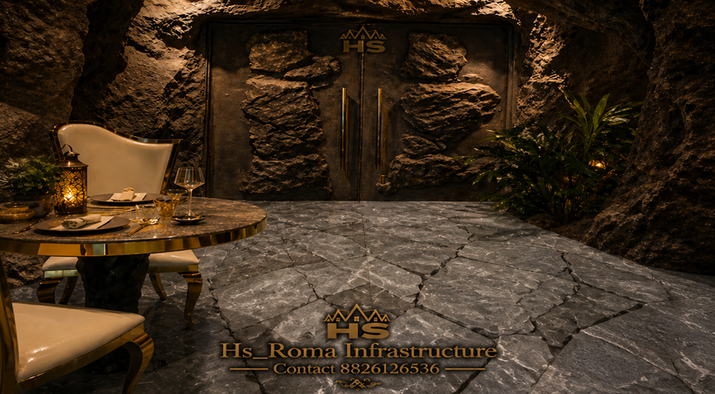

Slide 6
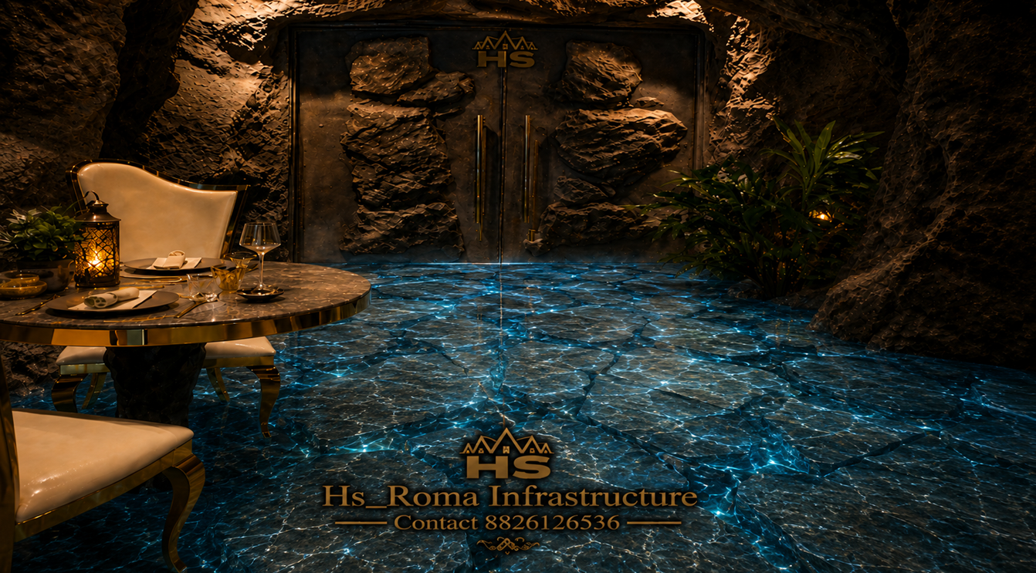

Slide 7
Notes:
A Cave-themed Restaurant an immersive dining venue designed to resemble a natural carvan,feathering rocky wall low light

Slide 8
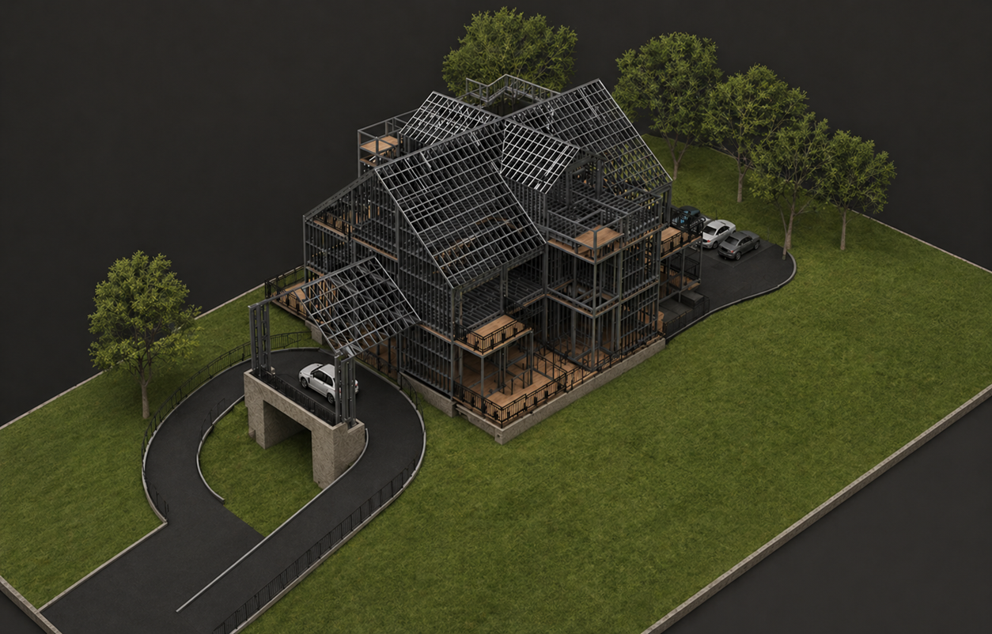
LGSF design for Motel and Restaurant Top Elevation

Slide 9
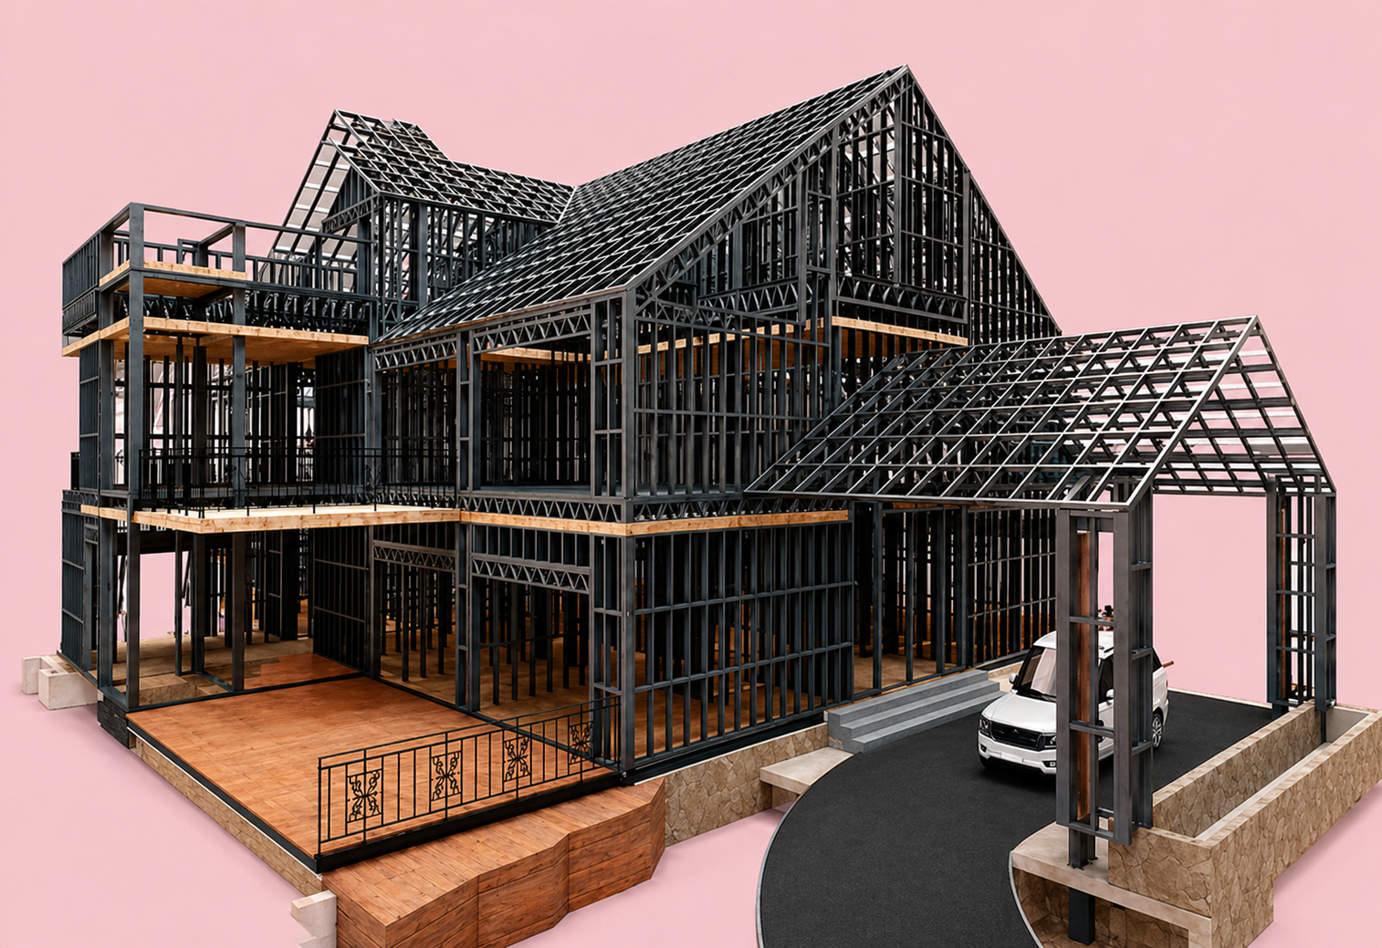
LGSF design for Motel and Restaurant
Top Elevation

